Slide 1


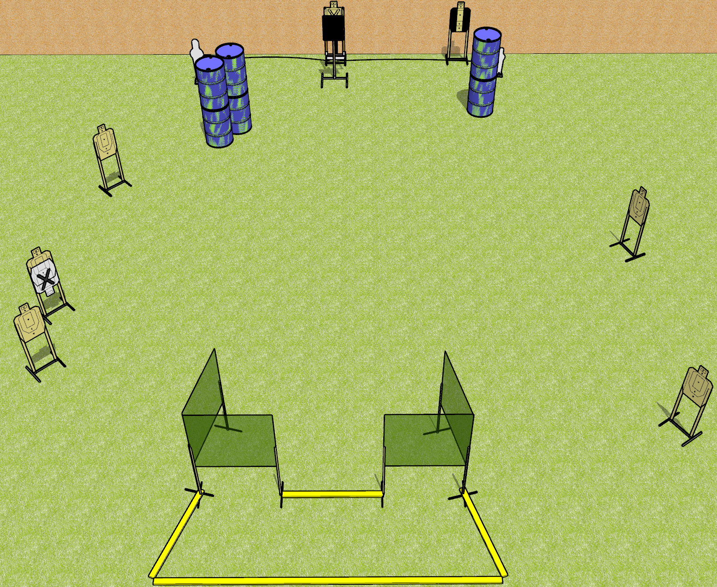
 | Dothan Gun Club – USPSA Match Yes Both Sides Course Designer : Drew Coleman
Round Count 16 rounds 7 USPSA targets 1 Pepper Popper, 1 Mini popper
Equipment List 8 wall feet 1 medium 1 bobber 1 18x24 inch plate + stand

Slide 2
Yes Both Sides
Written Stage Briefing
Yes Both Sides is a 16 round, 80 point, Comstock medium course. There are 7 USPSA targets, 1 pepper popper, and 1 USPSA mini popper. The best 2 hits on paper will score, and steel must fall to score. The start signal is audible.
The bobber is activated by either popper, and it is not a disappearing target. Please check the activator prior to walkthrough and make sure it set up the same way every time.
Handgun start position is anywhere inside the shooting area, wrists above shoulders. Handgun is loaded and holstered.
PCC start position is anywhere inside the shooting area. Loaded carbine is held with both hands, stock on belt, safety on.
On start signal, engage targets as they become available from within the shooting area.

